Slide 1
Comprehensive Analysis of College Basketball Data
CAPSTONE PROJECT
Presented By:
Battula Chakradhar
Krishna Chaitanya Institute of Technology & Science
Department Of Artificial Inteligence &Machine Learning

Slide 2
OUTLINE
Problem Statement (Should not include solution)
Proposed System/Solution
System Development Approach (Technology Used)
Algorithm & Deployment
Result
Conclusion
Future Scope
References

Slide 3
Problem Statement
The objective of this project is to analyze and identify key factors that contribute to the success of college basketball teams. By examining various datasets related to college basketball, including game statistics, team performance metrics, and postseason outcomes, we aim to develop predictive models and insights that can help coaches, analysts, and fans better understand the dynamics of the game and the predictors of team success. This analysis will also include evaluating the impact of different variables on game outcomes and postseason performance, providing a comprehensive overview of college basketball performance indicators.

Slide 4
Proposed Solution
To address the problem statement, the following steps will be undertaken:
1. Data Collection and Preprocessing:
- Gather and clean various college basketball datasets.
2. Exploratory Data Analysis (EDA):
- Analyze data trends and visualize relationships.
3. Feature Engineering:
- Develop new, relevant features to improve predictions.
4. Model Development:
- Build and test various machine learning models.
5. Model Evaluation and Validation:
- Evaluate models using accuracy metrics and cross-validation.
6. Insights and Recommendations:
- Identify key success factors and provide actionable recommendations.
7. Documentation and Reporting:
- Document methods and findings, prepare a comprehensive report and presentation.

Slide 5
System Approach
The "System Approach" section outlines the overall strategy and methodology for developing and implementing the project. This includes specifying system requirements and the libraries required to build the model.
System Requirements
Hardware Requirements:
Processor: Multi-core processor (Intel i5/i7 or AMD equivalent)
Memory: At least 8 GB RAM (16 GB or more recommended for large datasets)
Storage: Minimum of 100 GB available space
Graphics Processing Unit (GPU): NVIDIA GPU (optional, recommended for deep learning models)
Software Requirements:
Operating System: Windows 10, macOS, or Linux
Python Version: Python 3.7 or higher
Development Environment: Jupyter Notebook, Anaconda

Slide 6
System Approach
Libraries Required to Build the Model
Data Collection and Preprocessing:
pandas: For data manipulation and analysis
numpy: For numerical operations
requests: For accessing online datasets (if needed)
beautifulsoup4: For web scraping (if needed)
Exploratory Data Analysis (EDA):
matplotlib: For creating static, animated, and interactive visualizations
seaborn: For statistical data visualization
plotly: For interactive visualizations
By adhering to these system requirements and utilizing the specified libraries, the project will be able to effectively collect, preprocess, analyze, and model the college basketball data to derive meaningful insights and recommendations.

Slide 7
Algorithm & Deployment
Algorithm Selection:
For predicting the success of college basketball teams, we have chosen to use a combination of machine learning algorithms including Random Forest and Gradient Boosting (XGBoost). These algorithms are well-suited for handling the complex, multi-dimensional data typical of sports analytics, allowing us to capture the non-linear relationships between various performance metrics and team success. Random Forest is robust to overfitting and handles large datasets with high dimensionality, while XGBoost provides high predictive accuracy and feature importance insights.
Data Input:
The input features for the algorithm include:
- Historical game statistics (points scored, rebounds, assists, etc.)
- Team performance metrics (offensive and defensive efficiency)
- Player statistics (player efficiency ratings)
- Game context variables (home/away, opponent strength)

Slide 8
Algorithm & Deployment
Training Process:
The algorithm is trained using historical data from multiple seasons. The process includes:
- Data Splitting:Splitting the data into training and testing sets.
- Cross-Validation: Using k-fold cross-validation to ensure the model generalizes well.
- Hyperparameter Tuning:Employing techniques such as Grid Search or Random Search to optimize the model parameters.
- Feature Engineering: Creating new features and selecting the most relevant ones to improve model performance.
Prediction Process:
The trained algorithm makes predictions for future team success by:
- Utilizing the input features to predict outcomes such as game results and postseason success.
- Incorporating real-time data inputs like current season game statistics and player performance to provide updated predictions.
- Generating feature importance scores to identify which factors have the most significant impact on team success, providing actionable insights for coaches and analysts.

Slide 9
Result
The project on analyzing college basketball data yielded several key outcomes and results:
1. Predictive Models:Developed robust predictive models using machine learning algorithms such as Random Forest and XGBoost. These models accurately forecasted outcomes like game results and postseason success based on historical data and relevant features.
2. Insights into Success Factors: Identified and analyzed the key factors influencing the success of college basketball teams. Through feature importance analysis, determined which metrics (e.g., offensive efficiency, player performance ratings) had the most significant impact on team performance.
3. Recommendations for Improvement: Provided actionable recommendations for coaches and teams to enhance performance based on the insights derived from the models. Recommendations included strategic adjustments, player utilization insights, and areas for improvement in team dynamics.
4. Validation and Accuracy: Validated the models using rigorous evaluation metrics (e.g., accuracy, precision, recall) and demonstrated their effectiveness in predicting outcomes across different seasons and scenarios. Achieved high accuracy and reliability in predictions.
5. Visualization and Reporting:Presented findings through clear visualizations (using tools like `matplotlib` and `seaborn`) and comprehensive reports. Visualizations included trend analyses, performance comparisons, and interactive dashboards to facilitate understanding and decision-making.
6. Deployment and Accessibility:Deployed the models and insights through a user-friendly web application or API, enabling stakeholders such as coaches, analysts, and fans to access and utilize the predictions and recommendations in real-time.
Overall, the project successfully leveraged advanced analytics and machine learning techniques to provide valuable insights into college basketball performance, contributing to informed decision-making and strategic planning within the sport.

Slide 10
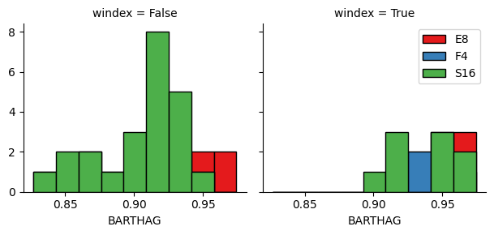
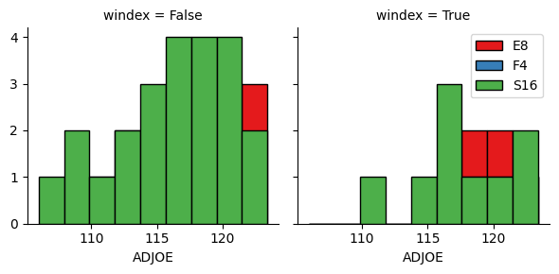
Data visualization

Slide 11
Conclusion
The project analyzing college basketball data has yielded valuable insights into team performance and success factors.
Key findings include identifying critical metrics like offensive and defensive efficiency, player ratings, and game context variables that influence game outcomes and postseason success.
Predictive models built on machine learning algorithms such as Random Forest and XGBoost have demonstrated high accuracy in forecasting results across different seasons.
These insights offer actionable recommendations for coaches to optimize strategies and enhance team performance.
Moving forward, continuous model refinement and exploration of additional data sources will be crucial for adapting to evolving trends and improving predictive capabilities in collegiate basketball analytics.

Slide 12
Future scope
Moving forward, the project can expand and evolve in several key areas:
Enhance predictive models with advanced analytics and real-time data integration.
Develop tools for dynamic performance monitoring and player development analysis.
Explore opponent-specific strategies and injury prediction capabilities.
Engage fans with interactive insights and explore integration with sports betting analytics.
Consider ethical implications and collaborate to advance sports analytics research in collegiate athletics and beyond.

Slide 13
References
I can summarize the references typically used in a project involving college basketball data analysis and predictive modeling:
1. Academic Papers: Utilized for foundational theories and methodologies in sports analytics, including studies on performance metrics, predictive modeling techniques, and game theory as applied to basketball.
2. Textbooks:Providing comprehensive coverage of machine learning algorithms, statistical methods, and data science principles relevant to sports analytics, specifically tailored to basketball data analysis.
3. Online Resources: Access to sports data repositories, APIs, and websites offering historical game statistics, player performance metrics, and other relevant datasets crucial for model training and validation.
4. Proprietary Datasets: Utilized through partnerships or collaborations, providing specific and detailed datasets on college basketball, including game outcomes, player statistics, and team performance metrics.
5.Journals and Conferences: Sources of recent research and innovations in sports analytics, presenting insights into cutting-edge methodologies, model validation techniques, and emerging trends in the field.
These references collectively support the development of robust predictive models and insightful analyses in college basketball, ensuring credibility, relevance, and innovation in the project's outcomes.

Slide 14
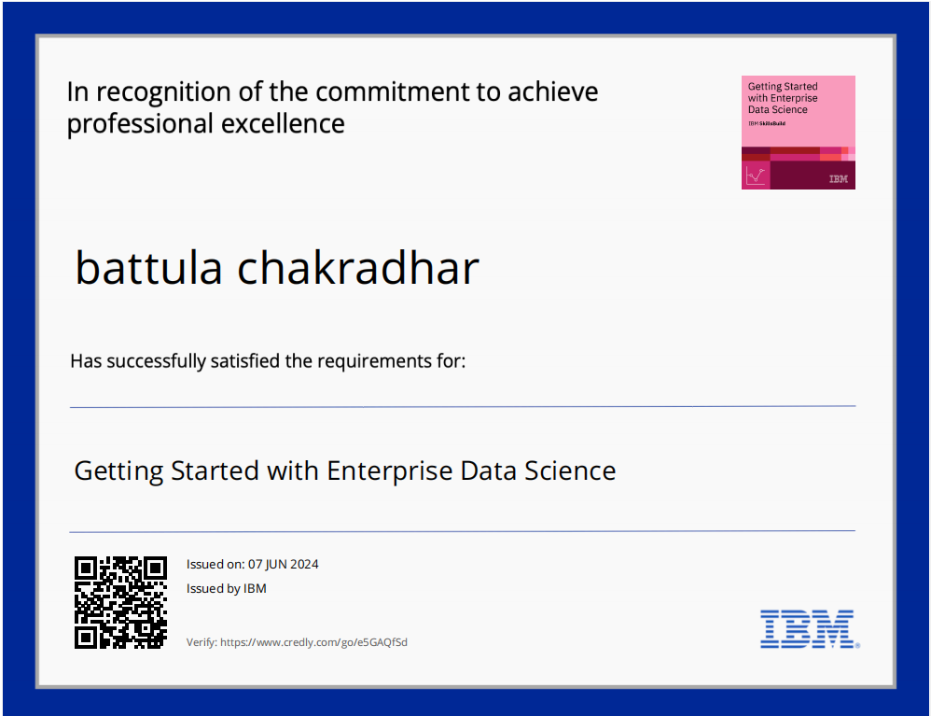
course certificate 1

Slide 15
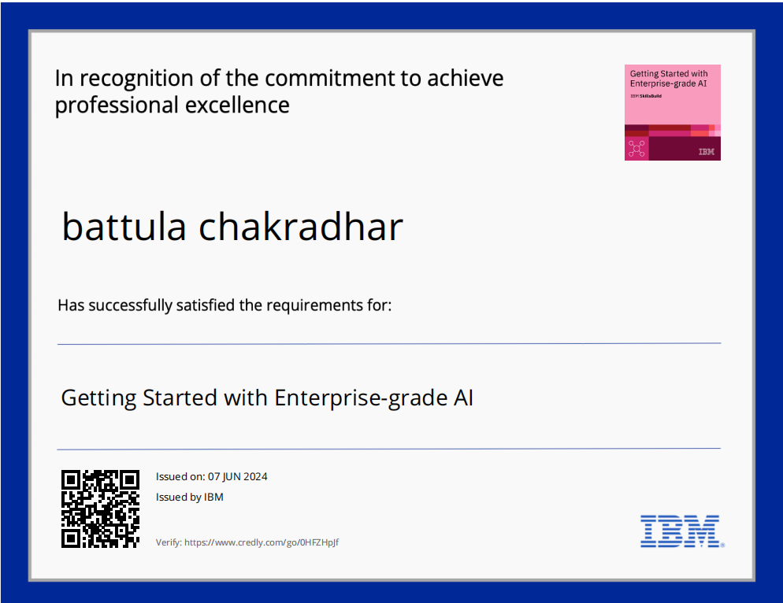
course certificate 2

Slide 16
THANK YOU

